Slide 1
Embedded Computing Hardware

Slide 2
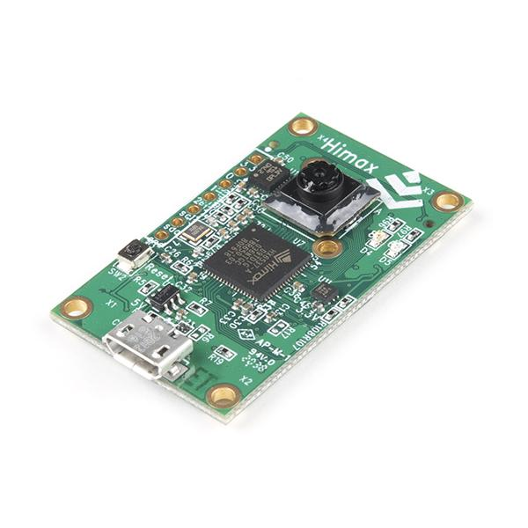
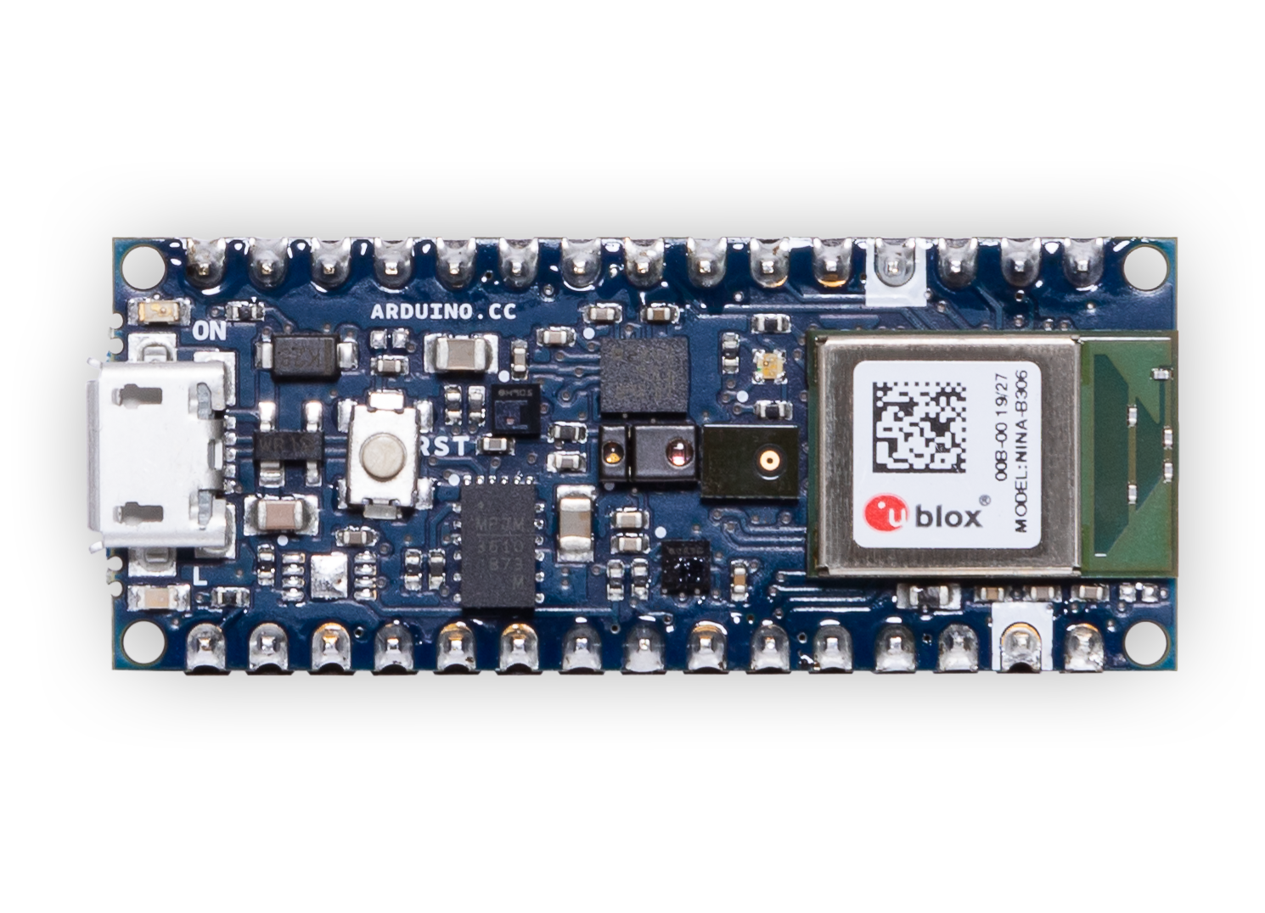
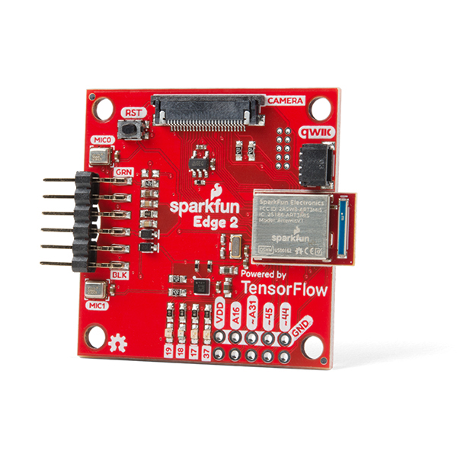
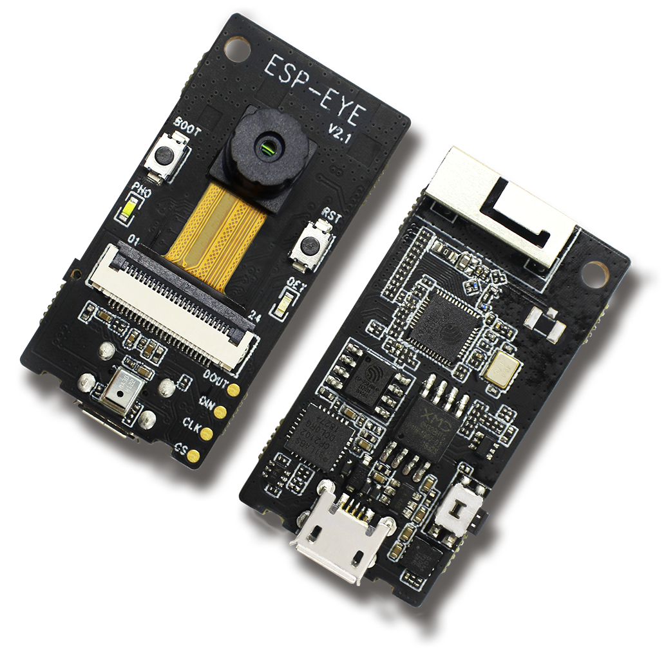
Computing Hardware
Board | MCU / ASIC | Clock | Memory | Sensors | Radio
Himax WE-I Plus EVB | HX6537-A 32-bit EM9D DSP | 400 MHz | 2MB flash 2MB RAM | Accelerometer, Mic, Camera | None
Arduino Nano 33 BLE Sense | 32-bit nRF52840 | 64 MHz | 1MB flash 256kB RAM | Mic, IMU, Temp, Humidity, Gesture, Pressure, Proximity, Brightness, Color | BLE
SparkFun Edge 2 | 32-bit ArtemisV1 | 48 MHz | 1MB flash 384kB RAM | Accelerometer, Mic, Camera | BLE
Espressif EYE | 32-bit ESP32-D0WD | 240 MHz | 4MB flash 520kB RAM | Mic, Camera | WiFi, BLE
Notes:
And we happen to choose one specific board which is Arduino nano 33 ble sense

Slide 3
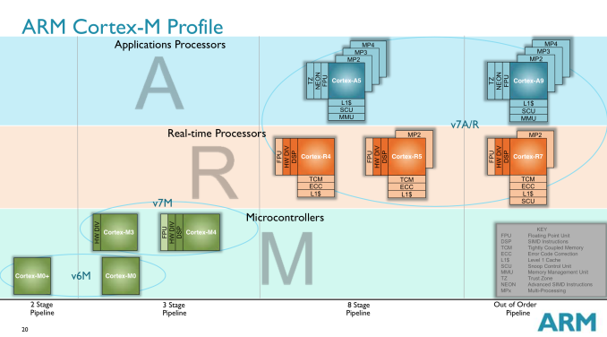
ARM Cortex Processor Profiles
Applications
Processors
Real-time
Processors
Microcontrollers
A5
A9
Power
DSP
DSP
FPU
FPU
HWDIV
HWDIV
R4
R5
R7
DSP
DSP
DSP
FPU
FPU
HWDIV
HWDIV
FPU
HWDIV
M3
M4
DSP
HWDIV
FPU
HWDIV
M0+
M0
Pipeline Complexity
Notes:
https://www.anandtech.com/show/8400/arms-cortex-m-even-smaller-and-lower-power-cpu-cores
2-axis (power, etc. v. complexity)

Slide 4
ARM Cortex Profiles
Applications
Processors
Real-time
Processors
Microcontrollers
A5
A9
Power
DSP
DSP
FPU
FPU
HWDIV
HWDIV
R4
R5
R7
DSP
DSP
DSP
FPU
FPU
HWDIV
HWDIV
FPU
HWDIV
M3
M4
DSP
HWDIV
FPU
HWDIV
M0+
M0
Pipeline Complexity
Notes:
https://www.anandtech.com/show/8400/arms-cortex-m-even-smaller-and-lower-power-cpu-cores
2-axis (power, etc. v. complexity)

Slide 5
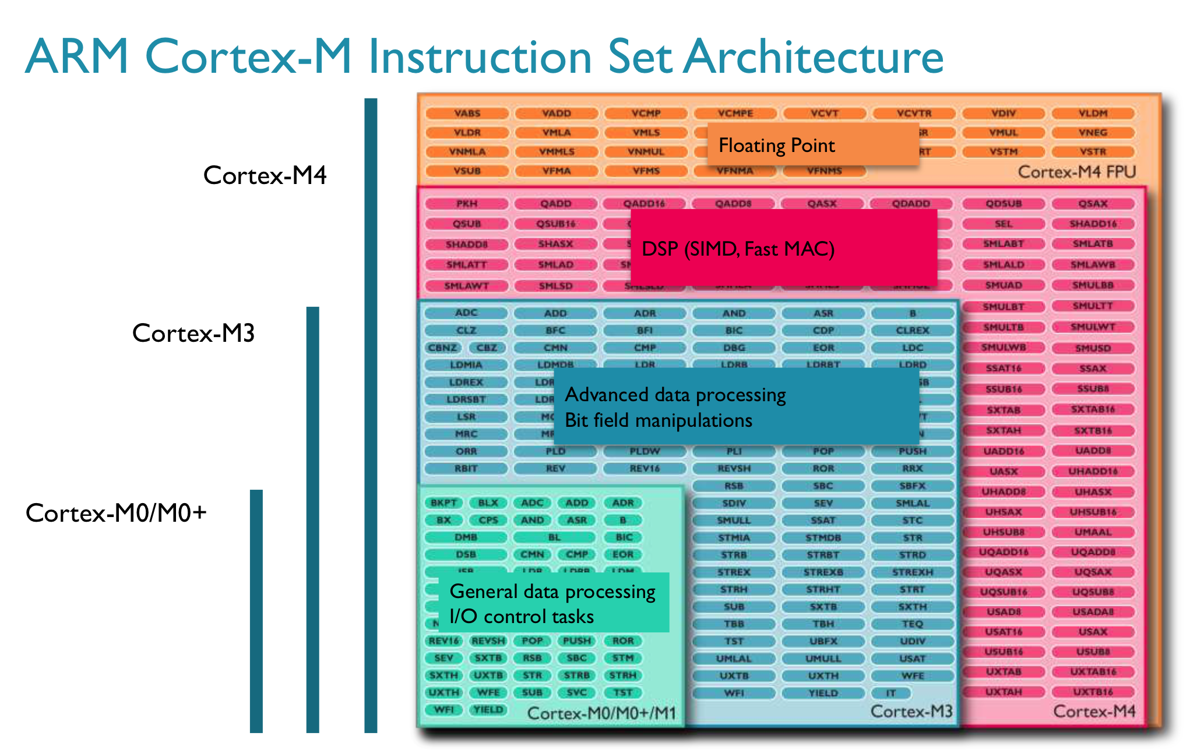
ARM Cortex-M ISA
Cortex-M0+/M0
General data
processing
I/O control tasks
M3
M4
DSP
HWDIV
FPU
HWDIV
M0+
M0
Notes:
ISA complexity: adding abilities
https://www.anandtech.com/show/8400/arms-cortex-m-even-smaller-and-lower-power-cpu-cores

Slide 6
ARM Cortex-M ISA
Cortex-M3
Advanced data processing
Bit field manipulations
Cortex-M0+/M0
General data
processing
I/O control tasks
M3
M4
DSP
HWDIV
FPU
HWDIV
M0+
M0
Notes:
ISA complexity: adding abilities
https://www.anandtech.com/show/8400/arms-cortex-m-even-smaller-and-lower-power-cpu-cores

Slide 7
ARM Cortex-M ISA
DSP (SIMD, Fast MAC)
Cortex-M3
Advanced data processing
Bit field manipulations
Cortex-M0+/M0
General data
processing
I/O control tasks
M3
M4
DSP
HWDIV
FPU
HWDIV
M0+
M0
Notes:
ISA complexity: adding abilities
https://www.anandtech.com/show/8400/arms-cortex-m-even-smaller-and-lower-power-cpu-cores

Slide 8
ARM Cortex-M ISA
Cortex-M4
FPU
DSP (SIMD, Fast MAC)
Cortex-M3
Advanced data processing
Bit field manipulations
Cortex-M0+/M0
General data
processing
I/O control tasks
M3
M4
DSP
HWDIV
FPU
HWDIV
M0+
M0
Notes:
ISA complexity: adding abilities
https://www.anandtech.com/show/8400/arms-cortex-m-even-smaller-and-lower-power-cpu-cores

Slide 9
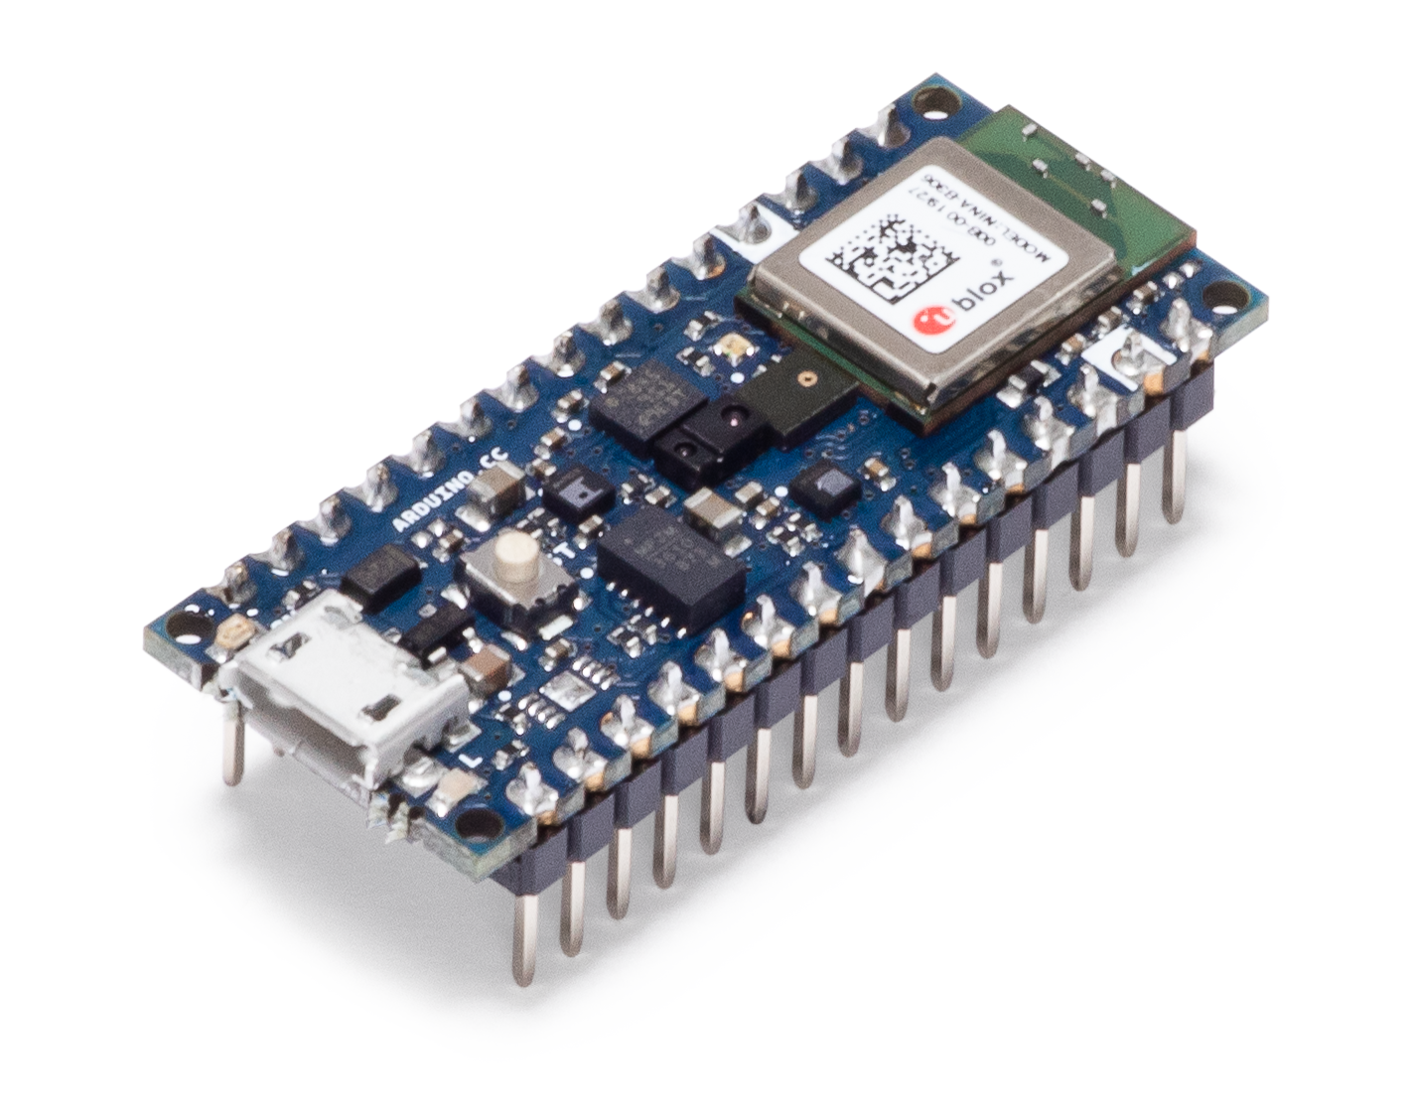
Board | Microcontroller | Clock | Memory | Sensors | Radio
Arduino Nano 33 BLE Sense | 32-bit nRF52840-M4 | 64 MHz | 1MB flash 256kB RAM | Mic, IMU, Temp, Humidity, Gesture, Pressure, Proximity, Brightness, Color | BLE
Notes:
Recurring theme: back to why we chose this

